Slide 1
JavaScript Essentials
JavaScript Overview

Slide 2
Table of Contents
Overview
What is JavaScript doing
Add JavaScript to web page
Structure of a JavaScript Program
Think like a Programmer

Slide 3

Lesson Objectives
Understand the high-level definition of JavaScript
Understand what JavaScript do to our web page
Understand the fundamentals of Programming
Able to think like Programmer

Slide 4
Overview
Section 1

Slide 5
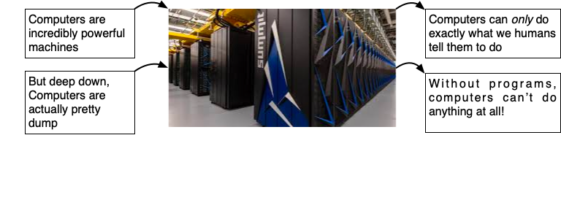
Overview – Fact about Computer
Notes:
Computers are incredibly powerful machines, capable of performing amazing feats like playing competitive chess, serving thousands of web pages, or making millions of complex calculations in less than a few seconds.
But deep down, computers are actually pretty dumb. Computers can only do exactly what we humans tell them to do.
We tell computers how to behave using computer programs, which are just sets of instructions for the computers to follow. Without programs, computers can’t do anything at all!

Slide 6
Overview – Meet JavaScript
Even worse, computers can’t understand English or any other spoken language.
Computer programs are written in a programming language like JavaScript
The JavaScript programming language is used to write programs that run in web pages.
JavaScript can control how a web page looks or make the page respond when a viewer clicks a button or moves the mouse.

Slide 7
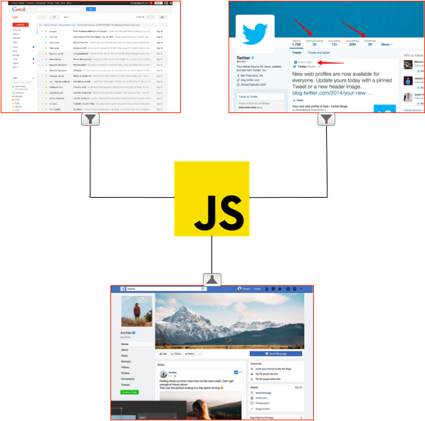
Overview – Who uses JavaScript
Notes:
Sites like Gmail, Facebook, and Twitter use JavaScript to make it easier to send email, post comments, or browse web- sites.
For example, when you’re on Facebook reading news from your friends and you see more news at the bottom of the page as you scroll down, that’s JavaScript in action.

Slide 8
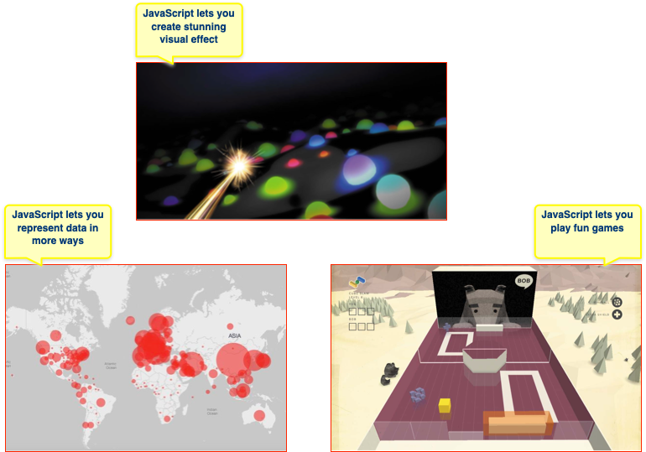
Overview – Much more

Slide 9
Overview – Why learn JavaScript?
It’s a lot easier (and more fun) to learn
In order to write and run JavaScript programs, all you need is a web browser
Share your JavaScript programs with other
Notes:
JavaScript isn’t the only programming language out there—in fact, there are literally hundreds of programming languages.
But there are many reasons to learn JavaScript. For one, it’s a lot easier (and more fun) to learn than many other programming languages.
But perhaps best of all, in order to write and run JavaScript programs, all you need is a web browser like Internet Explorer, Mozilla Firefox, or Google Chrome.
Every web browser comes with a JavaScript interpreter that understands how to read JavaScript programs.
Once you’ve written a JavaScript program, you can send people a link to it, and they can run it in a web browser on their computer, too!

Slide 10
Overview – How to add JavaScript?
Internal JavaScript
JavaScript can be placed in the <body> and the <head> sections of an HTML page by using <script> tag
In the HTML page itself:
<html>
<head>
<script>
// JavaScript code here
</script>
</head>

Slide 11
Overview – How to add JavaScript?
External JavaScript
As a file, linked from the HTML page:
<head>
<script src=“script.js”>
</script>
</head>

Slide 12
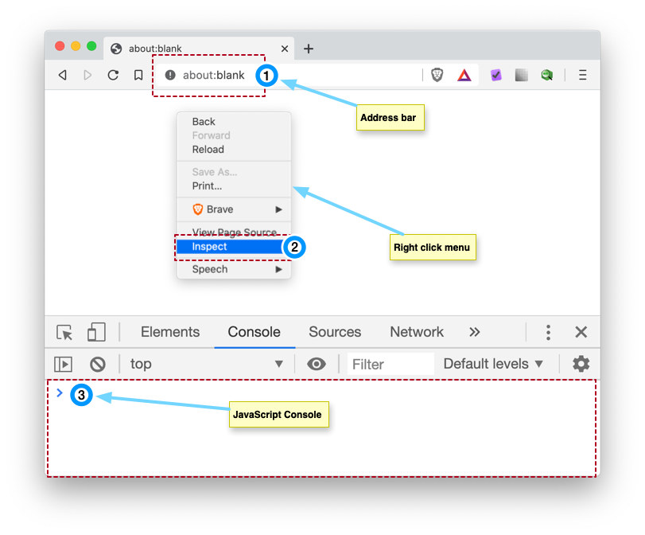
Overview – To test JavaScript
Open Chrome browser
Navigate to about:blank
Right Click and choose Inspect
Got to JavaScript Console by click on Console tab in
Start typing JavaScript cod and press Enter
Example: type 3 + 4; then press Enter

Slide 13
Overview – Demo
Demo: Add JavaScript to your web page
Notes:
Demo add JavaScript using
Internal JS
External JS
And using Chrome Console
For each demo: console.log(‘Hello Fresher’) is fine

Slide 14
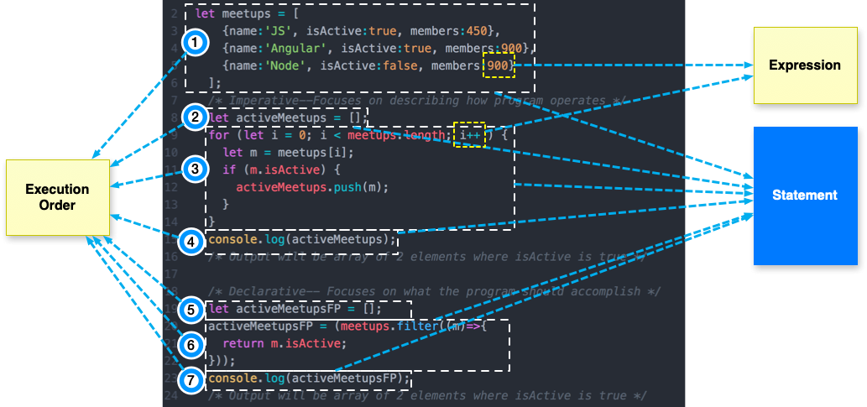
Overview – Structure of JavaScript Program
Notes:
You now know that a program is built out of statements, which themselves sometimes contain more statements.
Statements tend to contain expressions, which themselves can be built out of smaller expressions.
Putting statements after one another gives you a program that is executed from top to bottom.
You can introduce disturbances in the flow of control by using conditional (if, else, and switch) and looping (while, do, and for) statements.
Bindings can be used to file pieces of data under a name, and they are useful for tracking state in your program. The environment is the set of bindings that are defined. JavaScript systems always put a number of useful standard bindings into your environment.

Slide 15
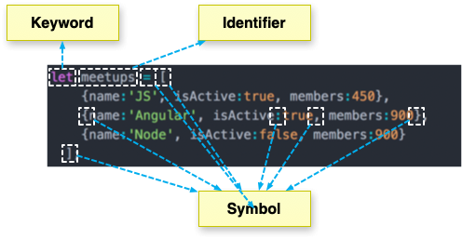
Overview – What is Syntax?
Notes:
Our program includes lots of symbols, including parentheses (), semicolons ;, curly brackets {}, plus signs +, and a few words that might seem mysterious at first (like var and console.log). These are all part of JavaScript’s syntax—that is, JavaScript’s rules for how to combine symbols and words to create working programs.
When you’re learning a new programming language, one of the trickiest parts is getting used to the rules for how to write different kinds of instructions to the computer. When you’re first starting out, it’s easy to forget when to include parentheses, or to mix up the order in which you need to include certain values. But as you practice, you’ll start to get the hang of it.
In this book, we’ll go slow and steady, introducing new syntax little by little so that you can build increasingly powerful programs.

Slide 16
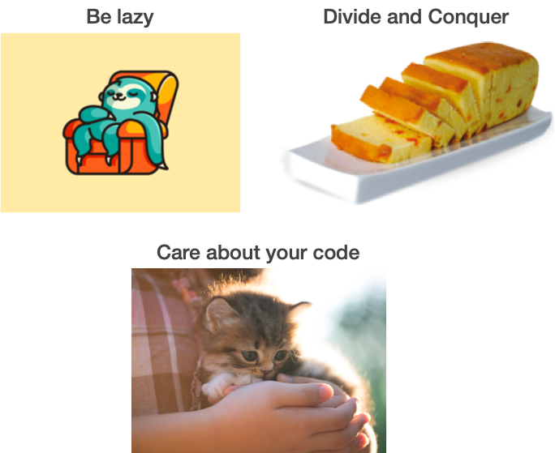
Overview – Think like a Programmer
Notes:
Be lazy
Divide and Conquer
Care about your code

Slide 17
Overview – Be lazy
Notes:
Be lazy: don’t repeat code

Slide 18
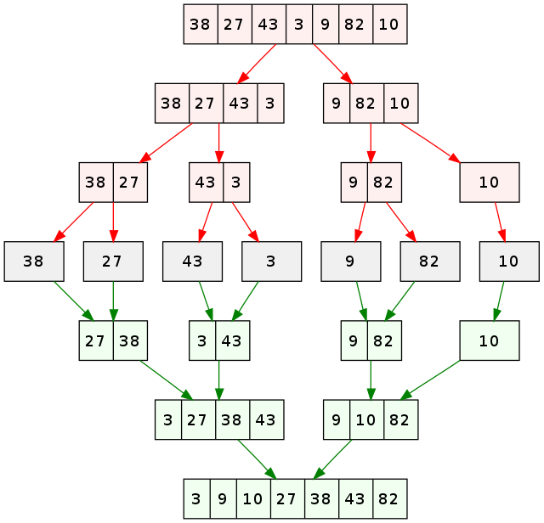
Overview – Divide and Conquer
Notes:
Divide and Conquer: explain about merge sort
Main idea: split the data into smaller trunks and solve the problem for the smaller trunks (which is much easy) then combine (Conquer)

Slide 19
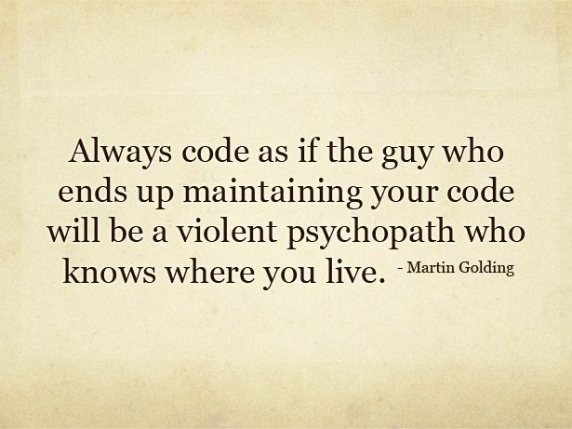
Overview – Care about your code
Notes:
Explain why we need to care about the code.
Code is previous asset of the project.
You don’t code for your self but other member in your team as well. Your code stays even if you move to another teams, another project, or even another company.
So always code with utmost care.

Slide 20
Overview – Summary
JavaScript program is built out of statements, which themselves sometimes contain more statements.
Statements tend to contain expressions, which themselves can be built out of smaller expressions.
JavaScript lets us build interactive, stunning web page
To think like a Programmer, you have to be lazy, divide the problem into smaller trunks, always care about your Code
Notes:
You now know that a program is built out of statements, which themselves sometimes contain more statements. Statements tend to contain expressions, which themselves can be built out of smaller expressions.
Putting statements after one another gives you a program that is executed from top to bottom. You can introduce disturbances in the flow of control by using conditional (if, else, and switch) and looping (while, do, and for) statements.
Bindings can be used to file pieces of data under a name, and they are useful for tracking state in your program. The environment is the set of bindings that are defined. JavaScript systems always put a number of useful standard bindings into your environment.
Functions are special values that encapsulate a piece of program. You can invoke them by writing functionName(argument1, argument2). Such a function call is an expression and may produce a value.

Slide 21

Thank you
Q&A

